Slide 1
Django – Full Stack Framework

Slide 2
MVC Architecture
MVC (Model-View-Controller) is a software architectural pattern that separates an application into three interconnected components: Model (data/logic), View (UI), and Controller (intermediary).
This separation ensures clean organization, allowing developers to modify the UI or backend logic independently

Slide 3
MVC Architecture
The Three Core Components
Model: Manages the data and core business logic. It holds the state of the application, interacts directly with the database, and notifies the view (or controller) when data changes.
View: Handles the layout, design, and user interface. It displays the information retrieved from the Model and captures user interactions to send to the Controller.
Controller: Acts as the "brain" or middleman. It receives user input from the View, processes application logic, updates the Model, and ultimately selects the appropriate View to render the final response.

Slide 4
MVC Architecture
How the Flow Works
A user interacts with the View (e.g., clicking a "Submit" button).
The View sends the user's action/request to the Controller.
The Controller interprets the action and calls the Model to update or fetch data.
The Model performs the necessary business logic, queries the database, and returns the updated state to the Controller.
The Controller passes this data to the correct View.
The View updates and renders the new state to the user

Slide 5
Django – MVT/MTV
In Django, the classic MVC (Model-View-Controller) design pattern is implemented a little uniquely.
Django’s creators actually describe its architecture as MVT (Model-View-Template).

Slide 6
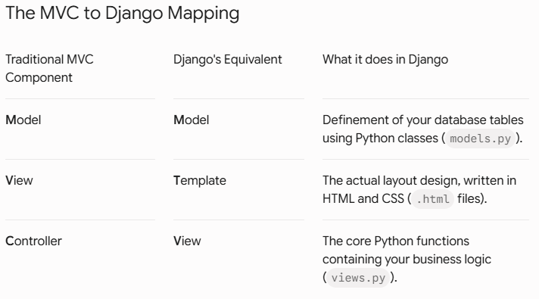

Slide 7
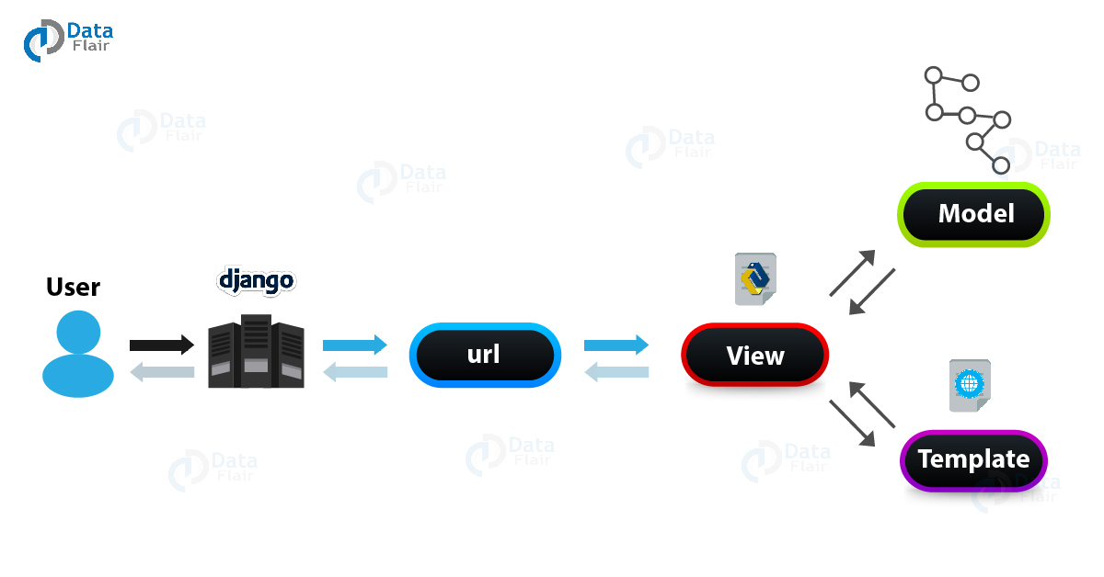
Django follows a Request-Response Lifecycle driven by the MVT (Model-View-Template) architecture. Unlike standard MVC patterns where a controller decides everything, Django handles routing via a URL dispatcher, maps it to a View, queries data via a Model, and renders it using a Template.

Slide 8
[ User Request ] ──> [ urls.py ] ──> [ views.py ] ───> [ models.py ] ───> [ Database ]
[ wsgi/asgi ] [ Template ] [ Processed Data ]
[ User Response ]

Slide 9
1. The Model (Data Layer)
Just like in traditional MVC, the Model is responsible for managing data.
Instead of writing raw SQL commands to create tables or extract rows, you write standard Python classes.
Django converts those classes into database tables automatically(ORM).
Where it lives: models.py
Analogy: The file cabinet or blueprint for your information.

Slide 10
2. The Template (The Presentation Layer — Traditional "View")
In traditional software terms, the "View" is what the user sees.
In Django, this is called the Template.
It consists of HTML files embedded with Django Template Language (DTL) tags (like {% for project in projects %}).
This allows Python to insert dynamic data cleanly into your web page's static visual elements.
Where it lives: Inside your app's templates/ folder.
Analogy: The blank document form waiting to be filled out with client details.

Slide 11
3. The View (The Logic Layer — Traditional "Controller")
In traditional MVC, the Controller acts as the brain—it takes user input, talks to the model, processes logic, and decides what to show. In Django, this brain function lives inside the View.
Where it lives: views.py
Analogy: The restaurant waiter who takes your order, carries it to the kitchen (Model), gets your food, plates it up beautifully, and presents it to your table (Template).

Slide 12
(The Request – Response Cycle)
When a user visits your website, Django passes the request through these layers in a precise loop:
The URL Router (urls.py): The user types in an address. Django’s routing configuration checks the pattern and directs the request to the matching function inside your View.
The View Execution (views.py): The View runs your Python logic.
The Model Request (models.py): The View reaches out to your Model to query the database. The Model pulls the correct data rows from your SQLite/PostgreSQL storage and hands them back to the View.
The Template Synthesis (home.html): The View takes that raw database entry and hands it off to your HTML Template.
The Response Delivery: Django stitches the dynamic data directly into the HTML format and ships a clean, rendered webpage straight back to the user's browser view.

Slide 13
URL Routing
URL routing is Django's mechanism for mapping browser requests (URLs) to specific Python code execution blocks (Views).
In Django, the URL router acts as the front desk receptionist of your web application. When a user enters a web address into their browser, the URL router instantly reads the request and determines which Python function (the View) should process it.
Every Django project maps these paths using list objects called urlpatterns within specialized Python configuration files named urls.py.

Slide 14
urlpatterns is just a standard Python list that you write inside a urls.py file.
Django reads this list from top to bottom every single time someone types an address into their web browser to find out where to send them.

Slide 15
How the Mapping Works
A standard Django web address map is created using the built-in path() function, which takes three primary arguments:
Python
path(route, view_function, name)
route: The text string matching the URL path typed into the browser bar (e.g., 'contact/'). An empty string ('') indicates the root homepage directory.
view_function: The specific Python function inside your views.py file that contains the processing logic to execute when this URL path is requested.
name: A unique text label assigned to the route. This allows you to link or redirect to this path anywhere else in your project using its name instead of hard coding raw paths like /my-app/dashboard/v2/.

Slide 16
Dynamic Routing
Imagine an online store with 10,000 different products. You would never write 10,000 static URL lines. Instead, you write one single dynamic path that acts as a catch-all variable catcher.
The App-Level Code (products/urls.py):
urlpatterns = [path('item/<int:product_id>/', views.product_detail_view, name='product_detail'), ]
The Matching View Logic (products/views.py):
from .models import Product
# Django grabs that number from the URL and automatically forces it into this function argument!
def product_detail_view(request, product_id):
  # If the URL was /item/582/, product_id becomes 582
  item = Product.objects.get(id=product_id)
  return render(request, 'detail.html', {'item': item})

Slide 17
Inside your single template file (detail.html):
<!-- This single file handles EVERY product -->
<html>
<head>
<title>{{ item.name }}</title>
</head>
<body>
<h1>{{ item.name }}</h1>
<p>Price: ${{ item.price }}</p>
<p>Description: {{ item.description }}</p>
</body>
</html>
How Django swaps the data based on the Product ID:
Scenario A: User visits /item/1/
  The View looks up Product #1 in the database: {"name": "Wireless Mouse", "price": 25}.
  Django passes this data to detail.html.
  The user sees a webpage titled Wireless Mouse with a price of $25.
Scenario B: User visits /item/2/
  The View looks up Product #2 in the database: {"name": "Mechanical Keyboard", "price": 80}.
  Django passes this data to the exact same detail.html file.
  The placeholder {{ item.name }} instantly updates, and the user sees Mechanical Keyboard with a price of $80.

Slide 18
Decoupled Routing (The Multi-App Project Model)
Imagine a complex university portal system that has a Student Management section and a separate Online Library section. Instead of jamming all the URLs into one master file, you decouple them by splitting them into separate files.

Slide 19
Step A: The Master Project Router (university_project/urls.py)
from django.contrib import admin
from django.urls import path, include
urlpatterns = [
path('admin/', admin.site.urls),
# If it starts with 'students/', throw it over to the student app
path('students/', include('student_portal.urls')),
# If it starts with 'library/', throw it over to the library app
path('library/', include('library_catalog.urls')),
]

Slide 20
The Independent App Routers (Decoupled Files)
Now, each app handles its own internal routing configuration locally inside its own folder completely independent of the other.
Inside the Student Portal app (student_portal/urls.py):
from django.urls import path
from . import views
urlpatterns = [
path('dashboard/', views.student_dashboard), # Full URL: /students/dashboard/
path('grades/', views.view_grades), # Full URL: /students/grades/
]
Inside the Library Catalog app (library_catalog/urls.py):
from django.urls import path
from . import views
urlpatterns = [
path('search/', views.book_search), # Full URL: /library/search/
path('renew/', views.renew_books), # Full URL: /library/renew/
]

Slide 21
View in Django
The view is a Python function (or class) that contains the actual core brain logic of your application.
It takes an incoming web request from a user, processes data, interacts with your database, and sends a response back to the browser.

Slide 22
What a View Actually Does (The 3-Step Lifecycle)
[ Incoming Request ] ── 1. Read Request ── 2. Process Logic / DB ── 3. Return Response
Receives an HttpRequest object: This object contains metadata about the user's action (e.g., what URL they visited, data they submitted in a form, or their login credentials).
Executes processing logic: This is where you write your Python code. It can run a machine learning pipeline, calculate a utility score, or run a query against a database.
Returns an HttpResponse object: A view must return a response. This can be a rendered HTML webpage, a redirect to another page, or raw data strings.

Slide 23
The Two Ways to Return Data from a View
Depending on whether you are building a traditional website or a headless data engine, your view will return data differently.
Method A: Returning Web Pages (Traditional MVT Setup)
If your backend is responsible for creating visual web pages, the view uses the render() helper function to stitch data into an HTML template file.
# projects/views.py
from django.shortcuts import render
from .models import Device
def device_dashboard_view(request):
# 1. Fetch data rows from the database
all_devices = Device.objects.all()
# 2. Package data and stitch it directly into an HTML file
return render(request, 'dashboard.html', {'devices': all_devices})

Slide 24
Method B: Returning Raw Data (Headless Backend Setup)
If you are building a headless system to pass raw information directly to a mobile app framework or a JavaScript frontend, the view bypasses HTML entirely and returns a JsonResponse.
# api/views.py
from django.http import JsonResponse
from .models import Device
def device_list_api(request):
# 1. Fetch data rows from the database
all_devices = Device.objects.all().values('id', 'status', 'battery_level')
# 2. Convert the database records into a standard Python list
data_list = list(all_devices)
# 3. Ship raw JSON text instantly across the network
return JsonResponse({"devices": data_list}, safe=False)

Slide 25
Templates in Django
In Django, Templates are the third pillar of the MVT (Model-View-Template) architecture. They handle the user interface (UI) and layout of your website.
Think of a Django template as a smart HTML file. It contains standard HTML code for structure and styling, mixed with special placeholder tags that allow Django to inject dynamic data from your database on the fly.

Slide 26
The Magic Syntax: Django Template Language (DTL)
Django doesn't just send static HTML to the browser. It uses its own built-in templating language to make HTML dynamic.
There are three core syntax elements you will use constantly:
Variables: {{ variable }} (The Placeholders)
Used when you want to print out a piece of data sent from your view (like a blog post title or an author's name).
<h1>{{ post.title }}</h1>
<p>Written by: {{ post.author }}</p>

Slide 27
Tags: {% tag %} (The Logic)
Used for logic processing, like looping through a list of items or checking a condition.
<!-- Looping through all your projects -->
{% for project in project_list %}
<h3>{{ project.title }}</h3>
{% empty %}
<p>No projects uploaded yet!</p>
{% endfor %}

Slide 28
Filters: {{ variable|filter }} (The Formatters)
Used to modify how a variable looks right inside the HTML layout before displaying it.
<!-- Capitalizes the text and formats a date cleanly -->
<p>{{ user.name|title }}</p>
<p>Published on: {{ post.date_published|date:"F j, Y" }}</p>

Slide 29
Advanced Template Feature: Template Inheritance
When building a blog or portfolio, you don't want to copy and paste your navigation bar, footer, and CSS links onto every single HTML page. Django fixes this with Template Inheritance.
You create one master "parent" layout file, and all other "child" files inherit from it and only fill in their unique content blocks.

Slide 30
Step 1: The Parent Layout (base.html)
This file defines the shared skeleton framework of your entire website.
<!-- templates/base.html -->
<!DOCTYPE html>
<html>
<head>
<title>My Website</title>
</head>
<body>
<nav>
<a href="/">Home</a> | <a href="/blog/">Blog</a>
</nav>
<!-- This is a blank container for child files to inject into -->
<div class="content">
{% block content %}
{% endblock %}
</div>
<footer>© 2026 My Portfolio Site</footer>
</body>
</html>

Slide 31
The Child Layout (blog_list.html)
This file inherits the base framework and only worries about its specific content.
<!-- templates/blog_list.html -->
{% extends 'base.html' %} <!-- Ties this file back to the master skeleton -->
{% block content %}
<h2>Latest Blog Posts</h2>
<p>Welcome to my blog! Here are my thoughts:</p>
<!-- Your loop logic goes here -->
{% endblock %}

Slide 32
How the View Connects to the Template
To send data to your template, your view wraps your database info inside a Python dictionary called a Context and hands it over to the render() function.
# blog/views.py
from django.shortcuts import render
from .models import Post
def blog_home(request):
posts = Post.objects.all()
# Context dictionary: The left side is the name your HTML file will read,
# the right side is the actual Python variable containing your data.
context = {'project_list': posts}
return render(request, 'blog_list.html', context)
When a user visits the page, Django merges blog_list.html, fills in the {% block content %} slot inside base.html, swaps all the {{ project.title }} loops with actual data, and ships a standard HTML file back to the user's browser.

Slide 33
Forms in Django
In Django, a Form is not just a collection of HTML tags; it is a powerful, object-oriented Python class that manages the entire lifecycle of user input.
Instead of forcing you to write complex code to render HTML inputs, check if data is missing, and prevent security vulnerabilities, Django encapsulates all of this behavior inside the django.forms module.

Slide 34
Django gives you three primary built-in classes to handle data collection, depending on where that data is going:
forms.Form (Standard Form)
What it is: A completely manual form class where you define every field from scratch.
When to use it: When the data you are collecting does not map directly to a database table.
Examples: Contact Us forms, search bars, or feedback questionnaires where you just want to process text and send an email without storing it in a database table.

Slide 35
forms.ModelForm (Model-Driven Form)
What it is: A specialized subclass that wraps around an existing database model (like your Task or UserProfile models). It automatically inspects your model's database configuration and creates all the form fields for you.
When to use it: When your form is meant to Create, Update, or Delete an actual row inside your database.
Key feature: Calling form.save() automatically inserts or updates the record in your database without requiring you to write SQL queries.
forms.FormSet (Form Collections)
What it is: A collection of multiple instances of the same form displayed on a single page.
When to use it: When you need to edit or add multiple records at the exact same time (e.g., adding 5 tasks at once or managing an entire roster of user profiles on a single spreadsheet-style grid).

Slide 36
The Validation Architecture (is_valid())
Validation is the security checkpoint of a Django Form. When you trigger if form.is_valid(): inside your view controller, Django initiates a strict, multi-step checking pipeline:

Slide 37
Field-Level Type Checking: Django checks basic parameters. If a field is marked as required=True but left empty, or if an email field doesn't contain an @ symbol, the form fails validation.
The "Clean" Methods: Django allows you to write custom validation rules using a naming convention: clean_<fieldname>(). Inside this method, you can write specific business logic, like making sure a task title doesn't contain banned words or checking if a password is long enough.
cleaned_data Dictionary: If every validation rule passes, Django throws away the raw, untrusted string text and moves the verified, safe values into a secure Python dictionary named form.cleaned_data. This is the only data that should ever be saved to your database.

Slide 38
Model in Django
In Django, a Model is a Python class that defines the structure and layout of a single database table. It acts as the Object-Relational Mapper (ORM) layer.
Instead of requiring you to write raw database queries like CREATE TABLE or INSERT INTO using SQL, Django allows you to write clean Python code. Django then translates your Python objects directly into database rows behind the scenes.

Slide 39
1. The Core Anatomy of a Model
When you create a model class, it inherits from models.Model. Every class attribute you define inside it represents a column in your database table.
from django.db import models
class Task(models.Model):
# 1. Character field (maps to VARCHAR in SQL)
title = models.CharField(max_length=200)
# 2. Text field for longer text (maps to TEXT in SQL)
description = models.TextField(blank=True, null=True)
# 3. Boolean flag (maps to BOOLEAN in SQL)
is_completed = models.BooleanField(default=False)
# 4. Date and Time stamp (maps to DATETIME in SQL)
created_at = models.DateTimeField(auto_now_add=True)
def __str__(self):
return self.title

Slide 40
The Invisible Primary Key
Django automatically assigns an auto-incrementing integer field named id to every model by default to act as the table's Primary Key.
2. Common Field Types & Attributes
Django includes built-in field types that match standard database column configurations:
CharField(max_length=...): Used for short text strings (requires a maximum length constraint).
TextField(): For large, multi-line blocks of text.
IntegerField() / FloatField(): For storing whole numbers or decimals.
DateTimeField(): For timestamps. Setting auto_now_add=True timestamps the row automatically when it is first created.

Slide 41
Core Field Modifications
default=...: Sets a fallback value if nothing is provided.
blank=True: Allows the field to be left empty in your frontend web forms.
null=True: Instructs the database layer to allow storing this value as NULL (empty).

Slide 42
3. The Migration Workflow (Syncing with the DB)
The database does not read Python directly. To turn your Python model code into hard tables inside your SQLite database (db.sqlite3), you must execute a two-step migration process in your VS Code terminal:
PowerShell
# Step A: Inspects models.py and creates a blueprint file tracking changes
python manage.py makemigrations
# Step B: Reads the blueprint and executes the actual SQL code to build/update tables
python manage.py migrate

Slide 43
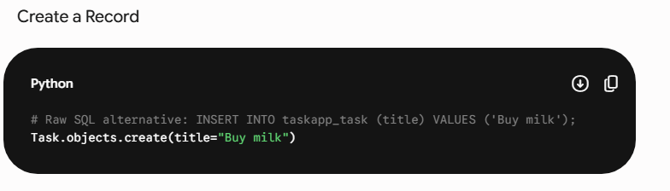
Querying Data via the ORM
Once your models are migrated, you never need to write raw SQL statements to interact with your data. Django provides an interface named Manager via .objects to run operations directly in Python:

Slide 44
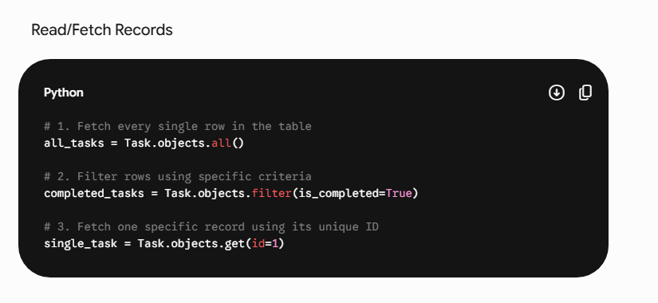

Slide 45
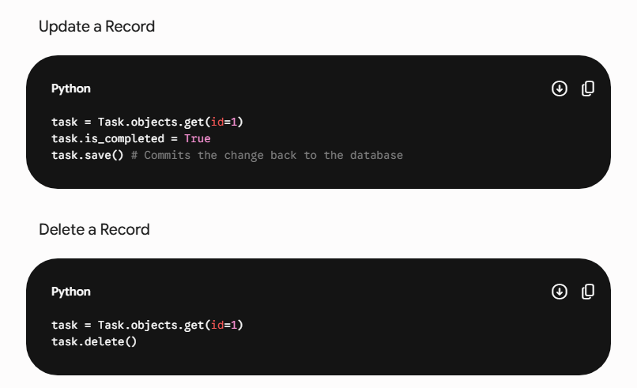

Slide 46
Database integration in Django
In Django, Database Integration is completely seamless because of its built-in Object-Relational Mapper (ORM).
By default, Django comes completely pre-configured to use SQLite—a lightweight, file-based database that requires zero installation or configuration. It runs out of a single file named db.sqlite3 inside your project folder, which is perfect for development.
However, when you are ready to move your application to production, Django can integrate with enterprise-grade relational databases like PostgreSQL, MySQL, or Oracle simply by updating a configuration dictionary.

Slide 47
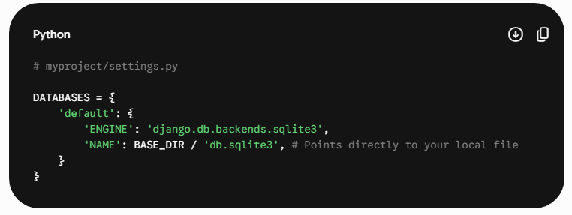
1. How Django Connects to a Database
Open your global project configurations file: myproject/settings.py. Scroll down until you find the DATABASES dictionary setting. This is where Django looks to find its database connection parameters.
The Default Configuration (SQLite)

Slide 48
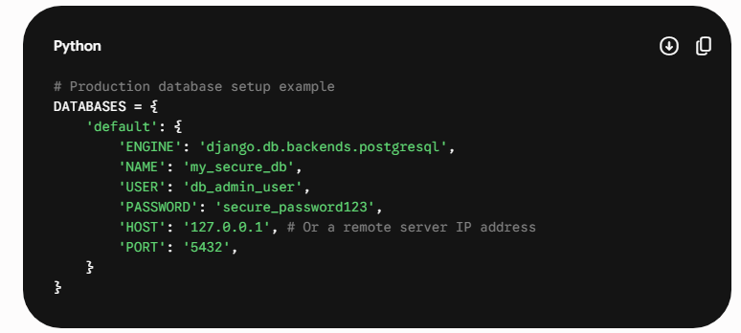
Switching to a Production Database (e.g., PostgreSQL)
If you wanted to connect your Django app to a standalone database server running on your computer or in the cloud, you don't change your views or models at all. You simply swap out that configuration engine block:

Slide 49
2. The Core Integration Architecture
Django handles data integration using a strict, single-direction pipeline:
Python Models (models.py): You write pure Python classes defining your application's data entities.
Migrations Engine: When you run python manage.py makemigrations, Django analyzes your classes and drafts a step-by-step structural translation blueprint file.
The ORM Driver: When you run python manage.py migrate, Django reads that blueprint, looks at your active DATABASES setting engine, and automatically generates the exact dialect of SQL commands (CREATE TABLE, ALTER COLUMN, etc.) needed for that specific target database.
[ Python Models ] ───> [ Migrations Blueprint ] ───> [ Django ORM Engine ] ───> [ SQL Translation ] ───> [ Target Database ]

Slide 50
Deployment in Django
Deploying a Django application means taking it off your local machine (127.0.0.1:8000) and putting it on a permanent cloud server so anyone on the internet can access it.
When you run python manage.py runserver, you are using a lightweight development server meant only for testing. For a real, production-ready deployment, you must wrap your app inside a professional environment.

